Slide 1
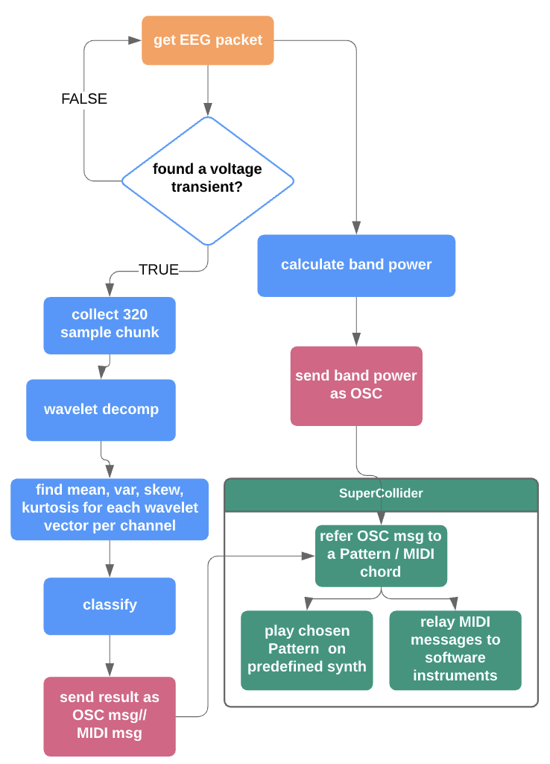
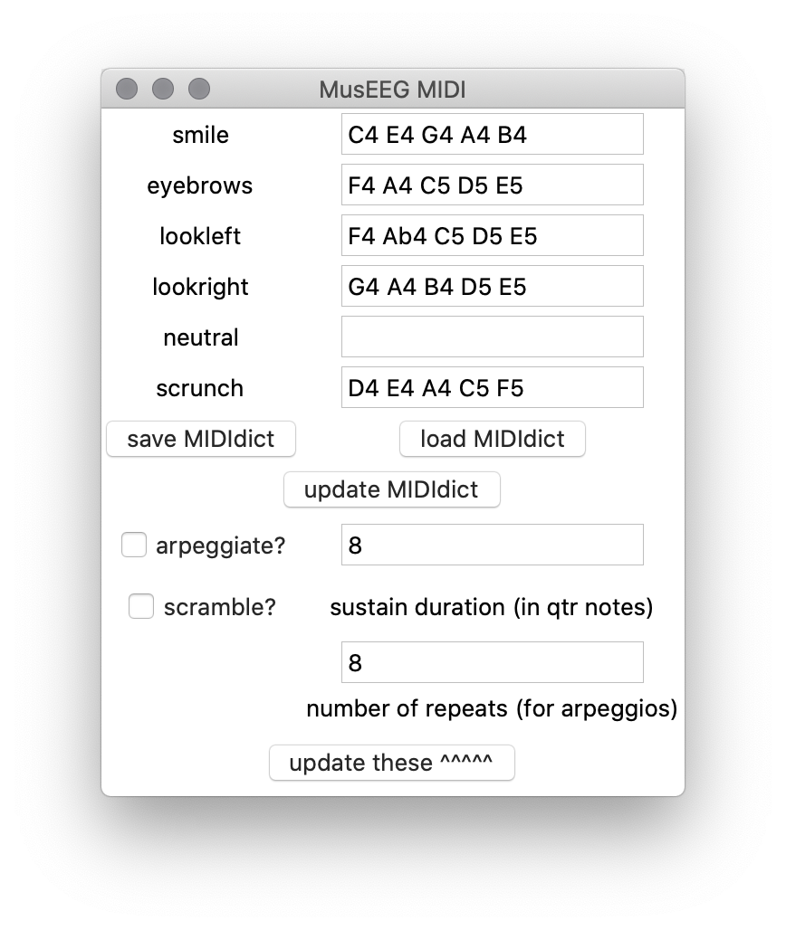
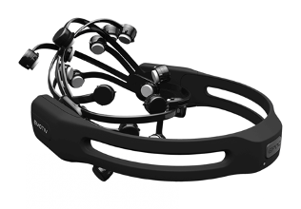
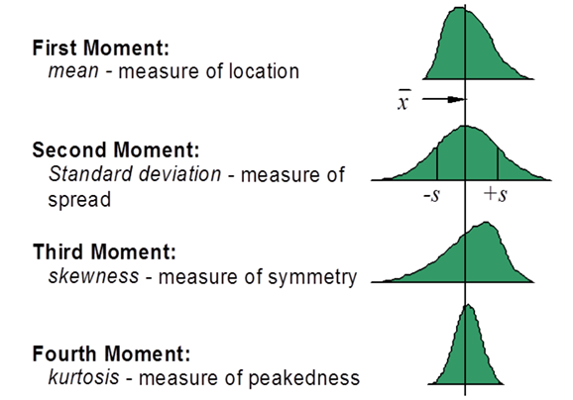
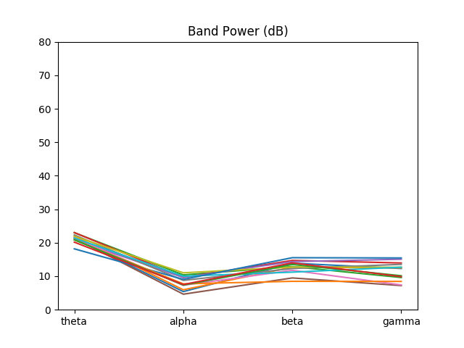
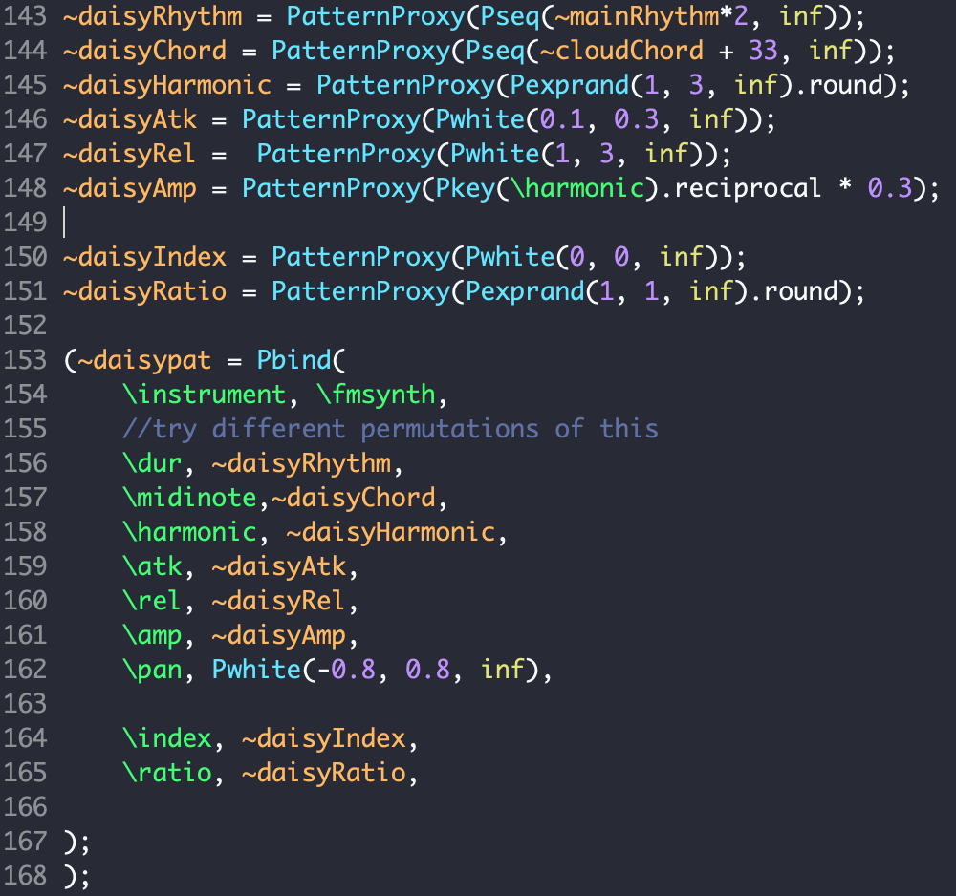
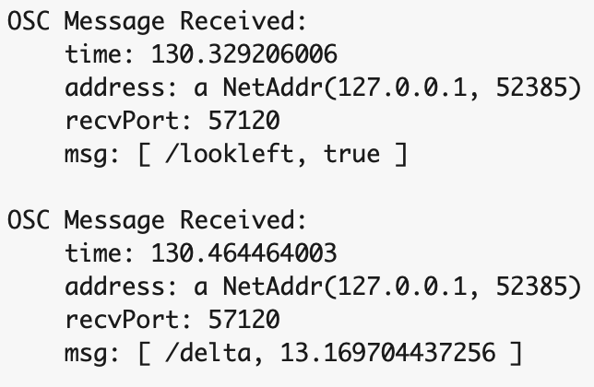
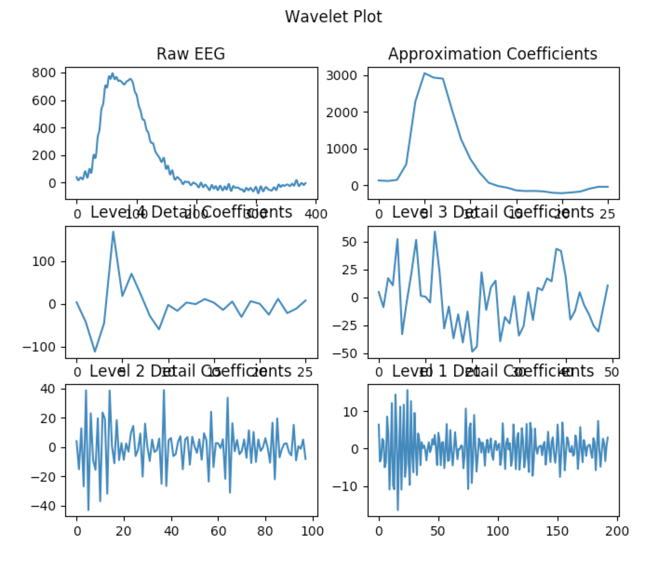
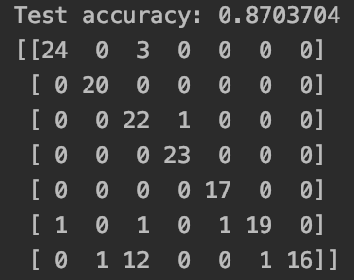


MusEEG: An Accessible, Facial Expression Brain-Computer Interface Hugo Flores Garcia Department of Electrical and Computer Engineering Faculty Mentors: Dr. Fernando Ríos, Dr. John Thompson
170
a
s
Abstract // Introduction
Program Flow
MIDI / Open Sound Control
A problem of accessibility in music
Brain Computer Music Interfaces (BCMIs) have been designed for numerous applications, such as musical neurofeedback, music composition, and special needs.
some of these systems are designed for medical or research grade EEG devices, making affordability an issue when considering widespread use.
A brain-computer interface that uses facial expression signals reduces the learning curve typically introduced by motor imagery (MI) systems, since MI EEG data requires significant user concentration to generate.
MIDI:
User is able to send MIDI chords
Ability to arpeggiate/ scramble note order
Save/Load MIDI dictionary presets
MusEEG:
Uses commercial grade Emotiv EPOC+
Facial Expressions are preprocessed using wavelet transform and statistical analysis, and classified using an Artificial Neural Network (ANN).
Classification result is sent to SuperCollider/Software Instrument via OSC/MIDI.
MusEEG MIDI Menu
Open Sound Control (OSC):
Discrete OSC messages with facial expression information
Continuous OSC messages with band power information
Can be used with other creative coding languages / frameworks (Max/MSP, openFrameworks)
More customizable than MIDI
EEG Headset
Artificial Neural Network
SuperCollider music programming
language
Music!
Feature Extraction
s
Band Power Feature Extraction:
14-channel band power data is calculated using Welch's periodogram.
Integrating PSD over frequency bands
Uses: Continuous Control (Vibrato, Aftertouch, Tremolo, etc)
Frequency Bands:
Theta (4 – 8 Hz)
Alpha (8 – 12 Hz)
Beta (12– 30 Hz)
Gamma (30 – 60 Hz)
SuperCollider
Band Power During Neutral State
MusEEG OSC Message in SuperCollider
Wavelet Analysis:
4-level wavelet decomposition using db2 wavelet.
Wavelet analysis varies the time-frequency aspect ratio, producing good frequency localization at low frequencies (long time windows) and good time localization at high frequencies (short time windows).
first four statistical moments (mean, variance, skewness, kurtosis) are calculated for each wavelet vector.
Pattern Definitions for a Generative Arpeggio Pattern
Problem: MusEEG sends a limited amount of discrete commands
Solution: SuperCollider’s Pattern system allows control of higher-level musical events (chords, phrases, drum beats, pre-recorded samples) instead of single notes
OSCdefs execute a callback function upon receiving a band power or facial expression message from MusEEG.
Example: A Generative Arpeggio Pattern
A smile expression randomly chooses a new chord from a pre-existing chord bank.
A scrunch expression increases the number of overtones to choose from.
A raise eyebrows expression decreases the number of overtones to choose from.
A look left expression decreases note density with respect to time.
A look right expression increases note density with respect to time.
Example: A Generative Drum Beat Sequencer
A smile expression toggles the kick drum on and off.
A scrunch expression toggles the hi hat on and off.
A raise eyebrows expression toggles the snare drum on and off.
A look left expression decreases overall beat tempo.
A look right expression increases overall beat tempo.
Wavelet Decomposition of a Smile
Classification:
Input Features:
4 statistical moments x 5 wavelet vectors x 14 EEG channels
= 280 features for ANN model
Data is normalized using MinMaxScaler before ANN.
bigBrain (ANN)
Classifies 320-sample chunks (1.5s) to determine what facial expression is present (smile, scrunch, etc.
Confusion Matrix for ANN
2020 Student Research Symposium
Statesboro, Georgia
April 24, 2020

